Slide 1

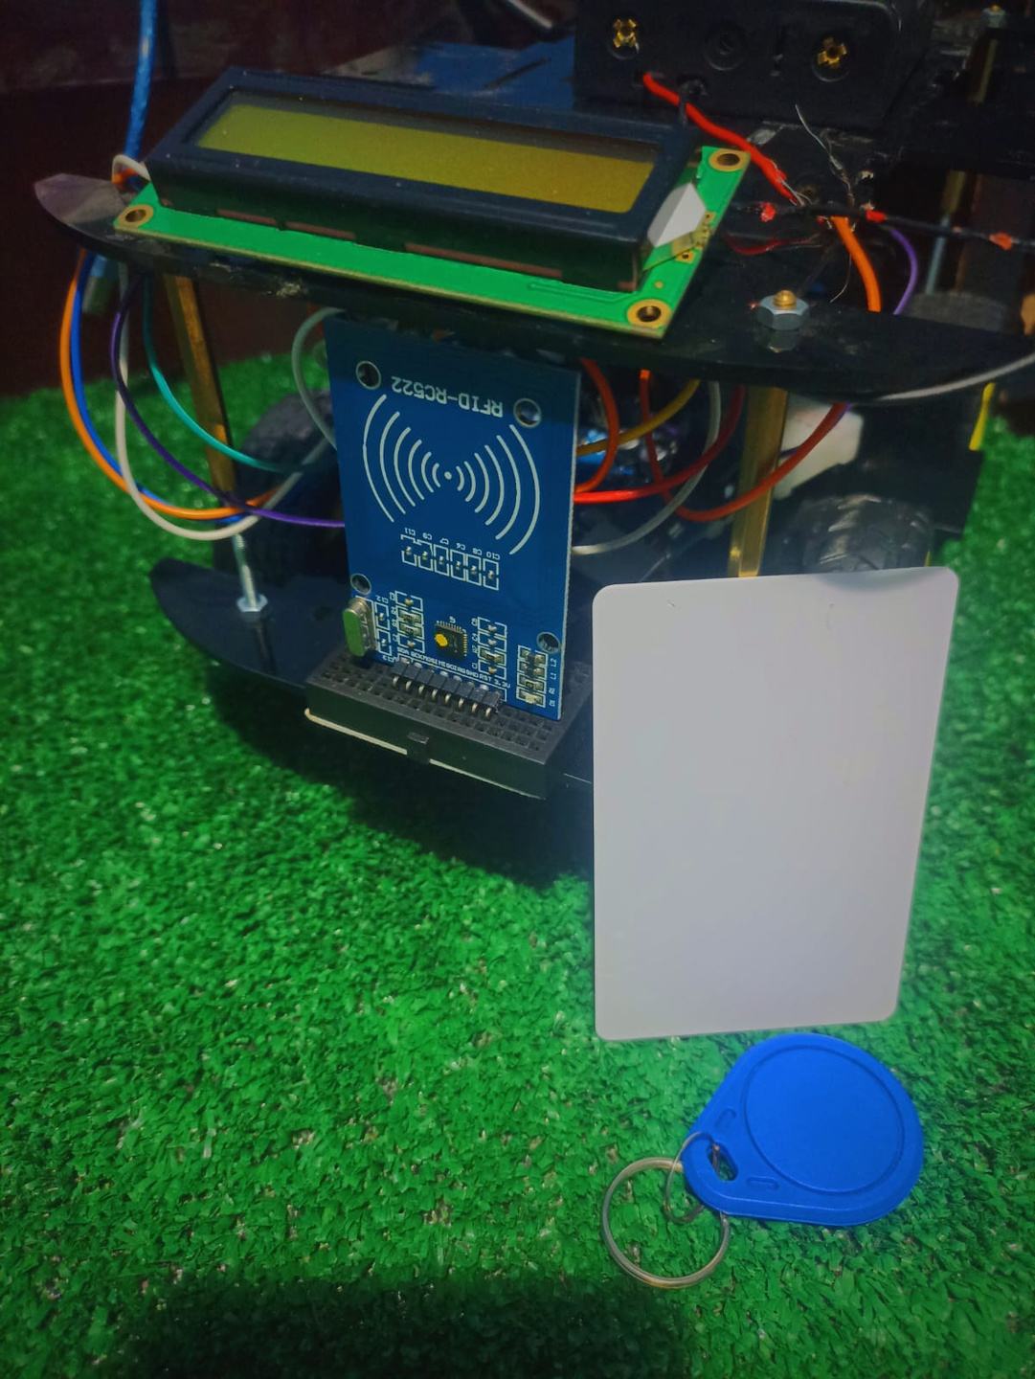

RFID TECHNOLOGY IN AUTONOMOUS ROBOTS
SUPERVISED BY:
DR.TAREK ABDELSHAHEED

Slide 2
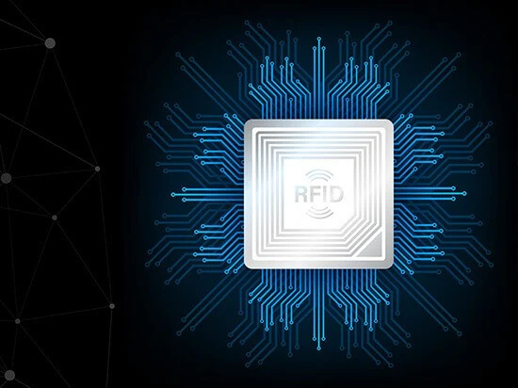
WHAT IS RFID TECHNOLOGY ?
RFID (Radio Frequency Identification) is a wireless technology that uses radio waves to identify and track objects. It enables the transfer of data between an RFID tag and a reader without the need for a direct line of sight.

Slide 3
TYPES OF RFID SYSTEMS
Low-Frequency (LF): Short range, used for access control.
High-Frequency (HF): Moderate range, used in inventory systems.
01
02
Ultra-High-Frequency (UHF): Long range, used in large-scale logistics.
03

Slide 4
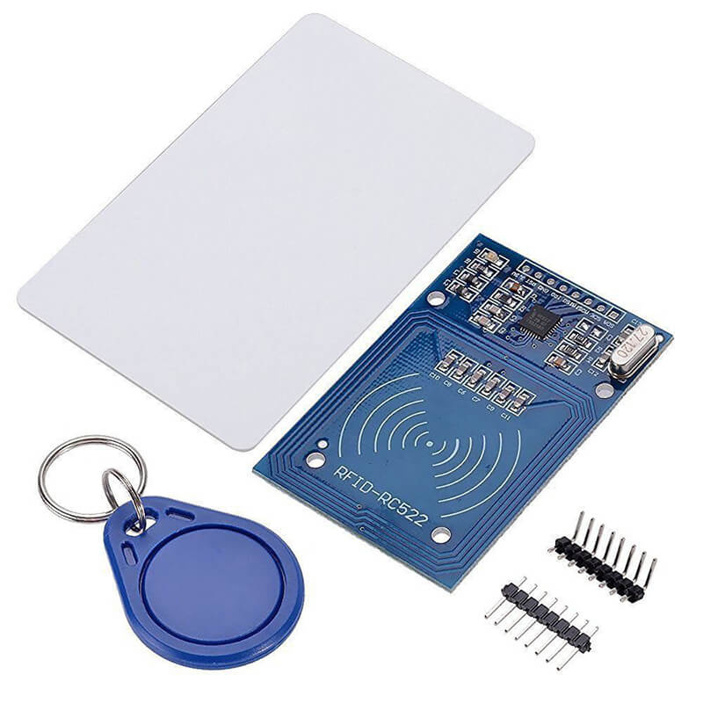
COMPONENS OF RFID SYSTEMS
RFID Tags:
1. Passive tags: Don’t need batteries and
work when near a reader.
2. Active tags: Use batteries, so they work
from farther away.
RFID Readers: The device that reads the data
from tags.

Slide 5
HOW DOES RFID WORKS ?
1)Reader sends radio waves into the air.
2)When a tag enters the range of these waves, it sends its
data back to the reader.
3)The reader collects the data and sends it to a computer
or robot.
4)The robot or system uses this information for tasks like navigation, tracking, or identifying items.

Slide 6
ADVANTAGES OF RFID IN ROBOTS
No need to see the tag directly (unlike barcodes).
Robots can read multiple tags at once, saving time.
01
02
Works even in dusty or wet environments.
Passive tags are cheap, so they’re easy to use in many places.
03
04

Slide 7
CHALLENGES OF RFID IN ROBOTS
01
Interference:
Signals can get blocked by metal or other electronic devices.
Cost:
Active tags are more expensive.
03
02
Range:
Passive tags only work when they’re close to the reader.

Slide 8
RFID Communication Protocols
ISO Standards: ISO 18000 for RFID systems.
NFC (Near Field Communication): Short-range RFID technology.
01
03
02
EPC (Electronic Product Code): Standard for item-level tracking.

Slide 9
APPLICATIONS OF RFID IN ROBOTS
01
Localization:
RFID helps robots figure out where they are in a building.
Object Identification:
Robots use RFID to recognize items like boxes or tools.
03
02
Navigation:
Tags act like road signs, helping robots find their way

Slide 10
RFID FOR OBJECT IDENTIFICATION
Robots use RFID to:
Identify items like boxes or tools.
Sort objects into groups.
Keep track of where items are in a warehouse.

Slide 11

COMPONENTS
ARDUINO UNO
ARDUINO NANO
MFRC522(RFID)
LCD_I2C
MOTOR DRIVER
MOTORS
WHEELS
BREADBOARD
POWER SUPPLY
OUR
PROJECT

Slide 12
SUMMARY
RFID makes robots smarter by helping them identify, track, and navigate.
It’s cheap and reliable for many uses, especially with passive tags.
As technology improves, robots will be able to use RFID in even more advanced ways.

Slide 13
THANK YOU

